Slide 1
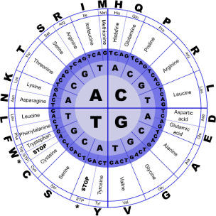
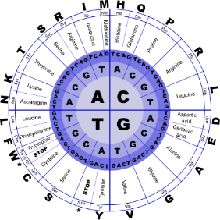


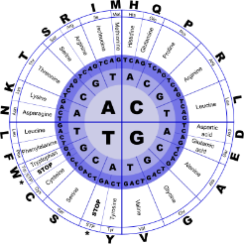
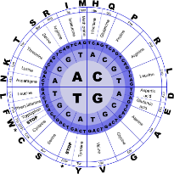
Fundamentals of Programming II
C++ - Introduction

Slide 2
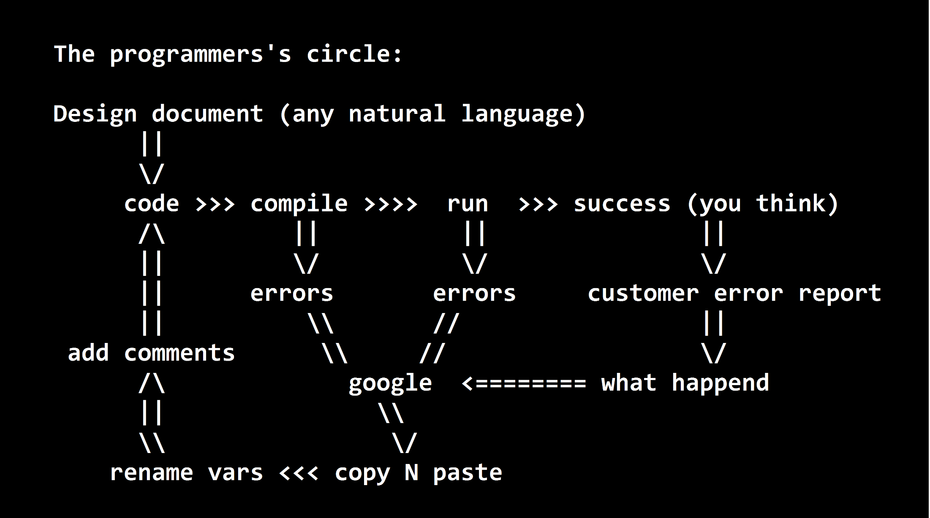
Circle of Coding

Slide 3
Designing a Program
Programs must be designed before they are written
Program development cycle
System requirement specification (SRS)
Development – coding, fixes syntax and logic errors
Implementation
System design document (SDD)
Test – unit test, integral system
Maintenance

Slide 4
Designing a Program
System Requirement Document
Work with customer to document the requirements for the program
Ask all questions about requirement in JAD sessions
Create software requirements document
Is the most important part of the program development cycle

Slide 5
Designing a Program
System Design Document
Break down required task into a series of steps
Create an algorithm, listing logical steps that must be taken
Under consideration
Service Oriented Architecture (SOA)
Data structure
Data independent semantics
Grouping common tasks
Determine the steps that must be taken to perform the task

Slide 6
Designing a Program
Informal language that has no syntax rule
Not meant to be compiled or executed
Used to create model program
No need to worry about syntax errors, can focus on program’s design
Can be translated directly into actual code in any programming language
Fake code
Pseudocode

Slide 7
Designing a Program
Computing Sales Tax
get price of item
get sales tax rate
sales tax = price of time times sales tax rate
final prince = price of item plus sales tax
display final price
halt
Note the three types of instructions
Pseudocode
input (get), process/calculate (=) and output (display)

Slide 8
Designing a Program
Diagram that graphically depicts the steps in a program
Ovals are terminal symbols
Parallelograms are input and output symbols
Rectangles are processing symbols
Symbols are connected by arrows that represent the flow of the program

Slide 9
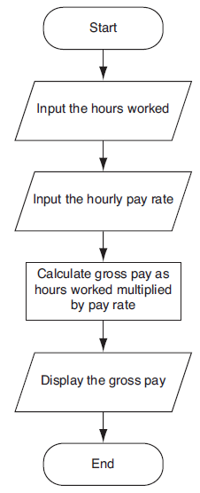
Designing a Program

Slide 10
Designing a Program
Input, Processing, and Output (IPO)
Receive input
any data that the program receives while it is running
Perform some process on the input
mathematical calculation
Produce output
print

Slide 11
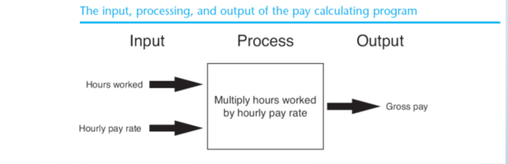
Designing a Program

Slide 12
C++ program
a collection of objects that communicate via invoking each other's methods.
Object
Class
Methods
Instance Variables
Objects have Properties and Behaviors. Example: A dog has Properties - color, name, breed as well as Behaviors - wagging, barking, eating. An object is an instance of a class.
A class can be defined as a template/blueprint that describes the behaviors/states that object of its type support.
A method is basically a behavior. A class can contain many methods. It is in methods where the logics are written, data is manipulated and all the actions are executed.
Each object has its unique set of instance variables. An object's state is created by the values assigned to these instance variables.

Slide 13
Parts of a C++ Program
// sample C++ program
#include <iostream>
using namespace std;
int main()
{
cout << "Hello, there!";
return 0;
}
comment
preprocessor directive
which namespace to use
beginning of function named main
beginning of block for main
output statement
send 0 back to operating system
end of block for main

Slide 14
Parts of a C++ Program
The C++ language defines several headers, which contain information that is either necessary or useful to your program. For this program, the header <iostream> is needed.
The line using namespace std; tells the compiler to use the std namespace. Namespaces are a relatively recent addition to C++.
The next line // main() is where program execution begins. is a single-line comment available in C++. Single-line comments begin with // and stop at the end of the line.
The line int main() is the main function where program execution begins.
The next line cout << "This is my first C++ program."; causes the message "This is my first C++ program" to be displayed on the screen.
The next line return 0; terminates main( )function and causes it to return the value 0 to the calling process.

Slide 15
Compile & Execute C++ Program
Open a text editor and add the code as above.
Save the file as: hello.cpp
Open a command prompt and go to the directory where you saved the file.
Type 'g++ hello.cpp ' and press enter to compile your code. If there are no errors in your code the command prompt will take you to the next line and would generate a.out executable file.
Now, type ' a.out' to run your program.
You will be able to see ' Hello World ' printed on the window

Slide 16
#include Directive
Inserts the contents of another file into the program
Is a preprocessor directive
Not part of the C++ language
Not seen by compiler
Example:
#include <iostream>
No ; goes here

Slide 17
Semicolons & Blocks in C++
-17
the semicolon
For example
x = y;
x = y; y = y+1; add(x, y);
is a statement terminator. That is, each individual statement must be ended with a semicolon. It indicates the end of one logical entity.
A block
is a set of logically connected statements that are surrounded by opening and closing braces.
y = y+1;
add(x, y);
x = y;
For example: { cout << "Hello World"; // prints Hello World return 0; }
C++ does not recognize the end of the line as a terminator. For this reason, it does not matter where on a line you put a statement.
For example:
y = y+1;
add(x, y);
is the same as

Slide 18
C++ Identifiers
A C++ identifier is a name used to identify a variable, function, class, module, or any other user-defined item.
C++ does not allow punctuation characters such as @, $, and % within identifiers.
An identifier starts with a letter A to Z or a to z or an underscore (_) followed by zero or more letters, underscores, and digits (0 to 9).
C++ is a case-sensitive programming language.
Thus, Manpower and manpower are two different identifiers in C++.
Is used to reference a location in memory where a value can be stored
Must be defined before it can be used
The value that is stored can be changed, i.e., it can “vary”

Slide 19
Assignment Statement
Uses the = (equal) operator
Has a single variable on the left side and a value on the right side
Copies the value on the right into the variable on the left
item = 12;

Slide 20
C++ Keywords
asm | else | new | this
auto | enum | operator | throw
bool | explicit | private | true
break | export | protected | try
case | extern | public | typedef
catch | false | register | typeid
char | float | reinterpret_cast | typename
class | for | return | union
const | friend | short | unsigned
const_cast | goto | signed | using
continue | if | sizeof | virtual
default | inline | static | void
delete | int | static_cast | volatile
do | long | struct | wchar_t
double | mutable | switch | while
dynamic_cast | namespace | template

Slide 21
Whitespace in C++
A line containing only whitespace, possibly with a comment, is known as a blank line, and C++ compiler totally ignores it.
Whitespace is the term used in C++ to describe blanks, tabs, newline characters and comments. Whitespace separates one part of a statement from another and enables the compiler to identify where one element in a statement, such as int, ends and the next element begins. Therefore, in the statement,
int age;there must be at least one whitespace character (usually a space) between int and age for the compiler to be able to distinguish them. On the other hand, in the statement
fruit = apples + oranges; // Get the total fruitno whitespace characters are necessary between fruit and =, or between = and apples, although you are free to include some if you wish for readability purpose.

Slide 22
Comments in C++
Program comments are explanatory statements that you can include in the C++ code that you write and helps anyone reading it's source code.
C++ supports single-line and multi-line comments.
C++ comments start with /* and end with */.
All programming languages allow for some form of comments.
All characters available inside any comment are ignored by C++ compiler.
A comment can also start with //, extending to the end of the line.
Within a /* and */ comment, // characters have no special meaning.
Within a // comment, /* and */ have no special meaning. Thus, you can "nest" one kind of comment within the other kind.

Slide 23
C++ Data Types
While doing programming in any programming language, you need to use various variables to store various information.
You may like to store information of various data types like character, wide character, integer, floating point, double floating point, boolean etc.
Variables are nothing but reserved memory locations to store values.
This means that when you create a variable you reserve some space in memory.
Based on the data type of a variable, the operating system allocates memory and decides what can be stored in the reserved memory.

Slide 24
C++ Data Types - Primitive Built-in Types
Type | Keyword
Boolean | bool
Character | char
Integer | int
Floating point | float
Double floating point | double
Valueless | void
Wide character | wchar_t

Slide 25
C++ Data Types - Primitive Built-in Types
Several of the basic types can be modified using one or more of these type modifiers:
signed
unsigned
short
long

Slide 26
Variable type
Type | Typical Bit Width | Typical Range
char | 1byte | -128 to 127 or 0 to 255
unsigned char | 1byte | 0 to 255
signed char | 1byte | -128 to 127
int | 4bytes | -2147483648 to 2147483647
unsigned int | 4bytes | 0 to 4294967295
signed int | 4bytes | -2147483648 to 2147483647
short int | 2bytes | -32768 to 32767
unsigned short int | 2bytes | 0 to 65,535
signed short int | 2bytes | -32768 to 32767

Slide 27
Variable type
Type | Typical Bit Width | Typical Range
long int | 8bytes | -9,223,372,036,854,775,808 to 9,223,372,036,854,775,807
signed long int | 8bytes | -9,223,372,036,854,775,808 to 9,223,372,036,854,775,807
unsigned long int | 8bytes | 0 to 18,446,744,073,709,551,615
float | 4bytes | +/- 3.4e +/- 38 (~7 digits)
double | 8bytes | +/- 1.7e +/- 308 (~15 digits)
long double | 8bytes | +/- 1.7e +/- 308 (~15 digits)
wchar_t | 2 or 4 bytes | 1 wide character

Slide 28
Variable type
The sizes of variables might be different from those shown in the above table, depending on the compiler and the computer you are using.

Slide 29
Enumerated Types
An enumerated type declares an optional type name and a set of zero or more identifiers that can be used as values of the type.
To create an enumeration requires the use of the keyword enum.
Each enumerator is a constant whose type is the enumeration.
The general form of an enumeration type is: enum enum-name { list of names } var-list;
the enum-name is the enumeration's type name. The list of names is comma separated.

Slide 30
Enumerated Types
Enumeration of colors called colors and the variable c of type color. Finally, c is assigned the value "blue"By default, the value of the first name is 0, the second name has the value 1, the third has the value 2, and so on.
You can give a name a specific value by adding an initializer. For example, in the following enumeration, green will have the value 5.
enum color { red, green, blue } c;
c = blue;
enum color { red, green = 5, blue } c;

Slide 31
Variable Declaration in C++ Types
A variable declaration provides assurance to the compiler that there is one variable existing with the given type and name so that compiler proceed for further compilation without needing complete detail about the variable.
A variable declaration has its meaning at the time of compilation only, compiler needs actual variable definition at the time of linking of the program.
A variable declaration is useful when you are using multiple files and you define your variable in one of the files which will be available at the time of linking of the program.
Though you can declare a variable multiple times in your C++ program, but it can be defined only once in a file, a function or a block of code.

Slide 32
Variable Declaration in C++ Types
/* Name Date Project ***************** Description This program will show how if statement works if number is positive then print positive number */ #include <iostream> // for cin, cout, endl using namespace std; int main () { // Variable definition: int number1 = 0; int number2 = 0; int sums = 0; float division; | // actual initialization number1 = 10; number2 = 20; sums = number1 + number2; cout << "The sum of 2 numbers is " << sums << endl ; division = 70.0/3.0; cout << "The division of 2 numbers is " << division << endl ; system ("pause"); // Freeze the DOS screen return 0; } // end of main()

Slide 33
Scope of Variable
A scope is a region of the program and broadly speaking there are three places, where variables can be declared −
Inside a function or a block which is called local variables,
In the definition of function parameters which is called formal parameters.
Outside of all functions which is called global variables.

Slide 34
Local Variables
Variables that are declared inside a function or block are local variables.
They can be used only by statements that are inside that function or block of code.
Local variables are not known to functions outside their own.
#include <iostream> using namespace std; int main () { // Local variable declaration: int a; int b; int c; // actual initialization a = 10; b = 20; c = a + b; cout << c << endl; system("pause"); return 0; } // end of main()

Slide 35
Global Variables
Global variables are defined outside of all the functions, usually on top of the program.
A global variable can be accessed by any function.
The global variables will hold their value throughout the life-time of your program.
That is, a global variable is available for use throughout your entire program after its declaration.
#include <iostream> using namespace std; // Global variable declaration: int g; int main () { // Local variable declaration: int a, b; // actual initialization a = 10; b = 20; g = a + b; cout << g << endl; system("pause"); return 0; }

Slide 36
Local & Global Variables
A program can have same name for local and global variables but value of local variable inside a function will take preference.
#include <iostream> using namespace std; // Global variable declaration: int g = 20; int main () { // Local variable declaration: int g = 10; cout << g << endl; system("pause"); return 0; }

Slide 37
Local & Global Variables
When a local variable is defined, it is not initialized by the system, you must initialize it yourself.
Global variables are initialized automatically by the system when you define them.
It is a good programming practice to initialize variables properly, otherwise sometimes program would produce unexpected result.
Data Type | Initializer
int | 0
char | '\0'
float | 0
double | 0
pointer | NULL

Slide 38
C++ Constants/Literals
Constants refer to fixed values that the program may not alter and they are called literals.
Constants can be of any of the basic data types and can be divided into Integer Numerals, Floating-Point Numerals, Characters, Strings and Boolean Values.
Again, constants are treated just like regular variables except that their values cannot be modified after their definition.

Slide 39
Integer literals
An integer literal can be a decimal, octal, or hexadecimal constant.
An integer literal can also have a suffix that is a combination of U and L, for unsigned and long, respectively. The suffix can be uppercase or lowercase and can be in any order.
A prefix specifies the base or radix: 0x or 0X for hexadecimal, 0 for octal, and nothing for decimal.
Examples of integer literals // decimal // octal 0x4b // hexadecimal 30 // int 30u // unsigned int 30l // long 30ul // unsigned long

Slide 40
Floating-point literals
A floating-point literal has an integer part, a decimal point, a fractional part, and an exponent part.
While representing using decimal form, you must include the decimal point, the exponent, or both and while representing using exponential form, you must include the integer part, the fractional part, or both.
You can represent floating point literals either in decimal form or exponential form.
The signed exponent is introduced by e or E.
Examples of floating point literals 3.14159 // Legal 314159E-5L // Legal 510E // Illegal: incomplete exponent 210f // Illegal: no decimal or exponent .e55 // Illegal: missing integer or fraction

Slide 41
Boolean literals
There are two Boolean literals and they are part of standard C++ keywords
You should not consider the value of true equal to 1 and value of false equal to 0.
A value of true representing true. A value of false representing false.

Slide 42
Character literals
Character literals are enclosed in single quotes.
A character literal can be a plain character (e.g., 'x'), an escape sequence (e.g., '\t'), or a universal character (e.g., '\u02C0').
There are certain characters in C++ when they are preceded by a backslash they will have special meaning and they are used to represent like newline (\n) or tab (\t).
A narrow character literal (e.g., 'x') and can be stored in a simple variable of char type.
Escape sequence | Meaning
\\ | \ character
\' | ' character
\" | " character
\? | ? character
\a | Alert or bell
\b | Backspace
\f | Form feed
\n | Newline
\r | Carriage return
\t | Horizontal tab
\v | Vertical tab
\ooo | Octal number of one to three digits
\xhh . . . | Hexadecimal number of one or more digits
int main () {
cout << "Hello\tWorld\n\n";
system("pause");
return 0;
}

Slide 43
String literals
String literals are enclosed in double quotes.
You can break a long line into multiple lines using string literals and separate them using whitespaces.
A string contains characters that are similar to character literals: plain characters, escape sequences, and universal characters.
"hello, dear"
"hello, \
dear"
"hello, " "d" "ear"

Slide 44
The const Keyword
Use const prefix to declare constants with a specific type
int main () {
const int LENGTH = 10;
const int WIDTH = 5;
const char NEWLINE = '\n';
int area;
area = LENGTH * WIDTH;
cout << area;
cout << NEWLINE;
system("pause");
return 0;
}

Slide 45
Arithmetic Operators
A = 10; B = 20
Operator | Description | Example
+ | Adds two operands | A + B will give 30
- | Subtracts second operand from the first | A - B will give -10
* | Multiplies both operands | A * B will give 200
/ | Divides numerator by de-numerator | B / A will give 2
% | Modulus Operator and remainder of after an integer division | B % A will give 0
++ | Increment operator, increases integer value by one | A++ will give 11
-- | Decrement operator, decreases integer value by one | A-- will give 9

Slide 46
Arithmetic Operators
int main () {
int a = 21;
int b = 10;
int c ;
c = a + b;
cout << "Line 1 - Value of c is :" << c << endl ;
c = a - b;
cout << "Line 2 - Value of c is :" << c << endl ;
c = a * b;
cout << "Line 3 - Value of c is :" << c << endl ;
c = a / b;
cout << "Line 4 - Value of c is :" << c << endl ;
c = a % b;
cout << "Line 5 - Value of c is :" << c << endl ;
c = a++;
cout << "Line 6 - Value of c is :" << c << endl ;
c = a--;
cout << "Line 7 - Value of c is :" << c << endl ;
return 0;
}

Slide 47
Relational Operators
A = 10; B = 20
Operator | Description | Example
== | Checks if the values of two operands are equal or not, if yes then condition becomes true. | (A == B) is not true.
!= | Checks if the values of two operands are equal or not, if values are not equal then condition becomes true. | (A != B) is true.
> | Checks if the value of left operand is greater than the value of right operand, if yes then condition becomes true. | (A > B) is not true.
< | Checks if the value of left operand is less than the value of right operand, if yes then condition becomes true. | (A < B) is true.
>= | Checks if the value of left operand is greater than or equal to the value of right operand, if yes then condition becomes true. | (A >= B) is not true.
<= | Checks if the value of left operand is less than or equal to the value of right operand, if yes then condition becomes true. | (A <= B) is true.

Slide 48
Relational Operators
int main () {
int a = 21;
int b = 10;
int c ;
if( a == b ) {
cout << "Line 1 - a is equal to b" << endl ;
} else {
cout << "Line 1 - a is not equal to b" << endl ;
}
if( a < b ) {
cout << "Line 2 - a is less than b" << endl ;
} else {
cout << "Line 2 - a is not less than b" << endl ;
}
if( a > b ) {
cout << "Line 3 - a is greater than b" << endl ;
} else {
cout << "Line 3 - a is not greater than b" << endl ;
}
/* Let's change the values of a and b */
a = 5;
b = 20;
if( a <= b ) {
cout << "Line 4 - a is either less than \ or equal to b" << endl ;
}
if( b >= a ) {
cout << "Line 5 - b is either greater than \ or equal to b" << endl ;
}
system("pause");
return 0;
}

Slide 49
Logical Operators
A = 1; B = 0
Operator | Description | Example
&& | Called Logical AND operator. If both the operands are non-zero, then condition becomes true. | (A && B) is false.
|| | Called Logical OR Operator. If any of the two operands is non-zero, then condition becomes true. | (A || B) is true.
! | Called Logical NOT Operator. Use to reverses the logical state of its operand. If a condition is true, then Logical NOT operator will make false. | !(A && B) is true.

Slide 50
Logical Operators
int main () {
int a = 5;
int b = 20;
int c ;
if ( a && b ) {
cout << "Line 1 - Condition is true"<< endl ;
}
if ( a || b ) {
cout << "Line 2 - Condition is true"<< endl ;
}
/* Let's change the values of a and b */
a = 0;
b = 10;
if ( a && b ) {
cout << "Line 3 - Condition is true"<< endl ;
} else {
cout << "Line 4 - Condition is not true"<< endl ;
}
if ( !(a && b) ) {
cout << "Line 5 - Condition is true"<< endl ;
}
system("pause");
return 0;
}

Slide 51
Assignment Operators
Operator | Description | Example
= | Simple assignment operator, Assigns values from right side operands to left side operand. | C = A + B will assign value of A + B into C
+= | Add AND assignment operator, It adds right operand to the left operand and assign the result to left operand. | C += A is equivalent to C = C + A
-= | Subtract AND assignment operator, It subtracts right operand from the left operand and assign the result to left operand. | C -= A is equivalent to C = C - A
*= | Multiply AND assignment operator, It multiplies right operand with the left operand and assign the result to left operand. | C *= A is equivalent to C = C * A
/= | Divide AND assignment operator, It divides left operand with the right operand and assign the result to left operand. | C /= A is equivalent to C = C / A
%= | Modulus AND assignment operator, It takes modulus using two operands and assign the result to left operand. | C %= A is equivalent to C = C % A

Slide 52
Misc. Operators
int main () {
cout << "Size of char : " << sizeof(char) << endl;
cout << "Size of int : " << sizeof(int) << endl;
cout << "Size of short int : " << sizeof(short int) << endl;
cout << "Size of long int : " << sizeof(long int) << endl;
cout << "Size of float : " << sizeof(float) << endl;
cout << "Size of double : " << sizeof(double) << endl;
cout << "Size of wchar_t : " << sizeof(wchar_t) << endl;
system("pause");
return 0;
}
The sizeof is a keyword, but it is a compile-time operator that determines the size, in bytes, of a variable or data type.
The sizeof operator can be used to get the size of classes, structures, unions and any other user defined data type.

Slide 53
Misc. Operators
The . (dot) operator and the -> (arrow) operator are used to reference individual members of classes, structures, and unions.
The dot operator is applied to the actual object.
The arrow operator is used with a pointer to an object.
To access members of a structure, use the dot operator. To access members of a structure through a pointer, use the arrow operator.
The (.) dot operator
To assign the value "zara" to the first_name member of object emp, you would write something as follows:
strcpy(emp.first_name, "zara");
The (->) arrow operator
If p_emp is a pointer to an object of type Employee, then to assign the value "zara" to the first_name member of object emp, you would write something as follows:
strcpy(p_emp->first_name, "zara");
struct Employee {
char first_name[16];
int age;
} emp;

Slide 54
Misc. Operators
int main () {
double a = 21.09399;
float b = 10.20;
int c ;
c = (int) a;
cout << "Line 1 - Value of (int)a is :" << c << endl ;
c = (int) b;
cout << "Line 2 - Value of (int)b is :" << c << endl ;
system("pause");
return 0;
}
A cast is a special operator that forces one data type to be converted into another.
As an operator, a cast is unary and has the same precedence as any other unary operator.

Slide 55
Misc. Operators
C++ provides two pointer operators, which are (a) Address of Operator & and (b) Indirection Operator *.
A pointer is a variable that contains the address of another variable or you can say that a variable that contains the address of another variable is said to "point to" the other variable. A variable can be any data type including an object, structure or again pointer itself.
The Address of Operator &
The & is a unary operator that returns the memory address of its operand. For example, if var is an integer variable, then &var is its address. This operator has the same precedence and right-to-left associativity as the other unary operators.
You should read the & operator as "the address of" which means &var will be read as "the address of var".
The Indirection Operator *
The second operator is indirection Operator *, and it is the complement of &.
It is a unary operator that returns the value of the variable located at the address specified by its operand.
int main () {
int var;
int *ptr;
int val;
var = 3000;
// take the address of var
ptr = &var;
// take the value available at ptr
val = *ptr;
cout << "Value of var :" << var << endl;
cout << "Value of ptr :" << ptr << endl;
cout << "Value of val :" << val << endl;
system("pause");
return 0;
}

Slide 56
Operators Precedence in C++
Category | Operator | Associativity
Postfix | () [] -> . ++ - - | Left to right
Unary | + - ! ~ ++ - - (type)* & sizeof | Right to left
Multiplicative | * / % | Left to right
Additive | + - | Left to right
Shift | << >> | Left to right
Relational | < <= > >= | Left to right
Equality | == != | Left to right
Bitwise AND | & | Left to right
Bitwise XOR | ^ | Left to right
Bitwise OR | | | Left to right
Logical AND | && | Left to right
Logical OR | || | Left to right
Conditional | ?: | Right to left
Assignment | = += -= *= /= %=>>= <<= &= ^= |= | Right to left
Comma | , | Left to right

Slide 57
Operators Precedence in C++
int main () {
int a = 20;
int b = 10;
int c = 15;
int d = 5;
int e;
e = (a + b) * c / d; // ( 30 * 15 ) / 5
cout << "Value of (a + b) * c / d is :" << e << endl ;
e = ((a + b) * c) / d; // (30 * 15 ) / 5
cout << "Value of ((a + b) * c) / d is :" << e << endl ;
e = (a + b) * (c / d); // (30) * (15/5)
cout << "Value of (a + b) * (c / d) is :" << e << endl ;
e = a + (b * c) / d; // 20 + (150/5)
cout << "Value of a + (b * c) / d is :" << e << endl ;
system("pause");
return 0;
}

Slide 58
C++ Basic Input/Output
The C++ standard libraries provide an extensive set of input/output capabilities which we will see in subsequent chapters.
C++ I/O occurs in streams, which are sequences of bytes.
If bytes flow from a device like a keyboard, a disk drive, or a network connection etc. to main memory, this is called input operation
if bytes flow from main memory to a device like a display screen, a printer, a disk drive, or a network connection, etc., this is called output operation.

Slide 59
I/O Library Header Files
Sr.No | Header File & Function and Description
1 | <iostream> This file defines the cin, cout, cerr and clog objects, which correspond to the standard input stream, the standard output stream, the un-buffered standard error stream and the buffered standard error stream, respectively.
2 | <iomanip> This file declares services useful for performing formatted I/O with so-called parameterized stream manipulators, such as setw and setprecision.
3 | <fstream> This file declares services for user-controlled file processing. We will discuss about it in detail in File and Stream related chapter.

Slide 60
The Standard Output Stream (cout)
The predefined object cout is an instance of ostream class.
The cout object is said to be "connected to" the standard output device, which usually is the display screen.
The cout is used in conjunction with the stream insertion operator, which is written as << which are two less than signs
The C++ compiler also determines the data type of variable to be output and selects the appropriate stream insertion operator to display the value.
The << operator is overloaded to output data items of built-in types integer, float, double, strings and pointer values.
The insertion operator << may be used more than once in a single statement as shown above and endl is used to add a new-line at the end of the line.

Slide 61
The Standard Output Stream (cout)
#include <iostream>
using namespace std;
int main () {
char str[] = "Hello C++";
cout << "Value of str is : " << str << endl;
system("pause");
return 0;
}

Slide 62
The Standard Input Stream (cin)
The predefined object cin is an instance of istream class.
The cin object is said to be attached to the standard input device, which usually is the keyboard.
The cin is used in conjunction with the stream extraction operator, which is written as >> which are two greater than signs
The C++ compiler also determines the data type of the entered value and selects the appropriate stream extraction operator to extract the value and store it in the given variables.
The stream extraction operator >> may be used more than once in a single statement.

Slide 63
The Standard Input Stream (cin)
#include <iostream>
using namespace std;
int main () {
char name[50];
cout << "Please enter your name: ";
cin >> name;
cout << "Your name is: " << name << endl;
system("pause");
return 0;
}

Slide 64
Math Expression to C++ Expression
2a + 4ab + 5a(b + c)

Slide 65
Math Expression to C++ Expression
(x + 2)(y + z)

Slide 66
Math Expression to C++ Expression
(x − 2)(x + 2) 8x

Slide 67

Math Expression to C++ Expression

Slide 68
Math Expression to C++ Expression
(x − 2)(x + 2) 8x

Slide 69
Logical Operators
The and Operator
Takes two Boolean expressions as operands
Creates compound Boolean expression that is true only when both sub expressions are true
Can be used to simplify nested decision structures
Truth table for the and operator
Value of the Expression | Expression
false | false and false
false | false and true
false | true and false
true | true and true

Slide 70
Logical Operators
The or Operator
Takes two Boolean expressions as operands
Creates compound Boolean expression that is true when either of the sub expressions is true
Can be used to simplify nested decision structures
Truth table for the or operator
Value of the Expression | Expression
false | false and false
true | false and true
true | true and false
true | true and true

Slide 71
Logical Operators
The not Operator
Takes one Boolean expressions as operand and reverses its logical value
Sometimes it may be necessary to place parentheses around an expression to clarify to what you are applying the not operator
Truth table for the not operator
Value of the Expression | Expression
false | true
true | false

